Slide 1
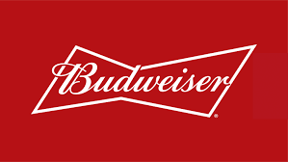
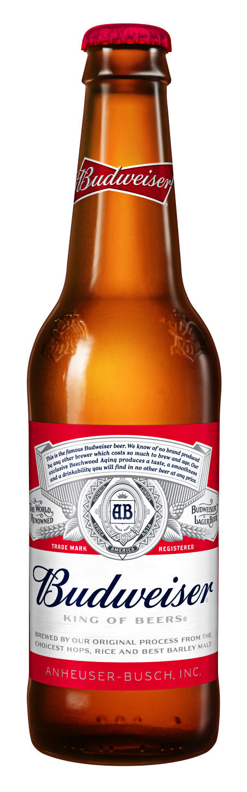
Budweiser Case study
By: Jordan Eaddy
Notes:
*Click Twice*
Hows it going?
My name is Jordan Eaddy and I am looking forward to answering all your questions.
I know youre extremly busy so I am going to do my best to keep this under 7 minutes

Slide 2


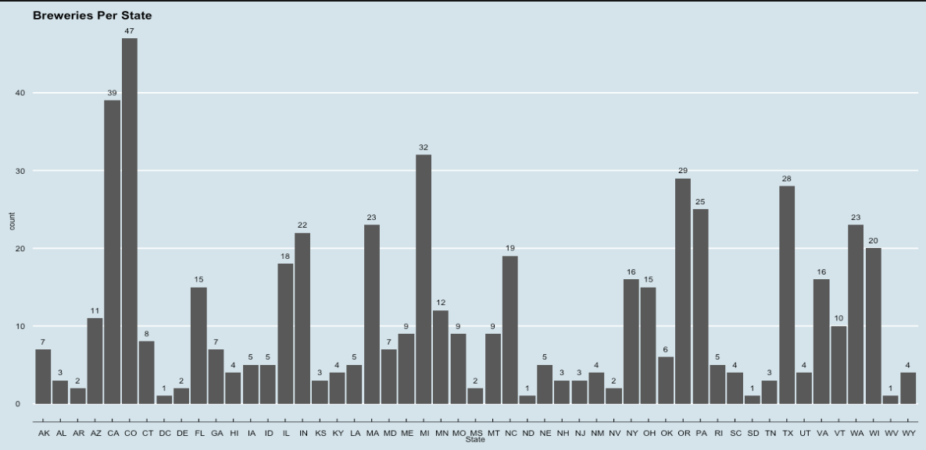
How many breweries are there in each state?
Top 3:
Colorado-47
California-39
Michigan-32
Notes:
we wanted to know how many breweries are there in each state:
The TOP THREE are
1st. Colorado with 47
California with 39
Michigan- with 32

Slide 3
State average alcohol and bitterness content
To address any missing data, I used the style(IPA or ale) average
West Virginia has the highest average international bitterness
Nevada has the highest average alcohol content
TOP 3 AVERAGE IBU
WEST VIRGINIA
ALABAMA
IDAHO
TOP 3 AVERAGE ABV
NEVADA
WASHINGTON DC
KENTUCKY
Notes:
We then wanted to know what each states beer content was like, was it bitter or higher in alchol
The states with highest average bitterness were
West Virginia
Alabama and Idaho

Slide 4
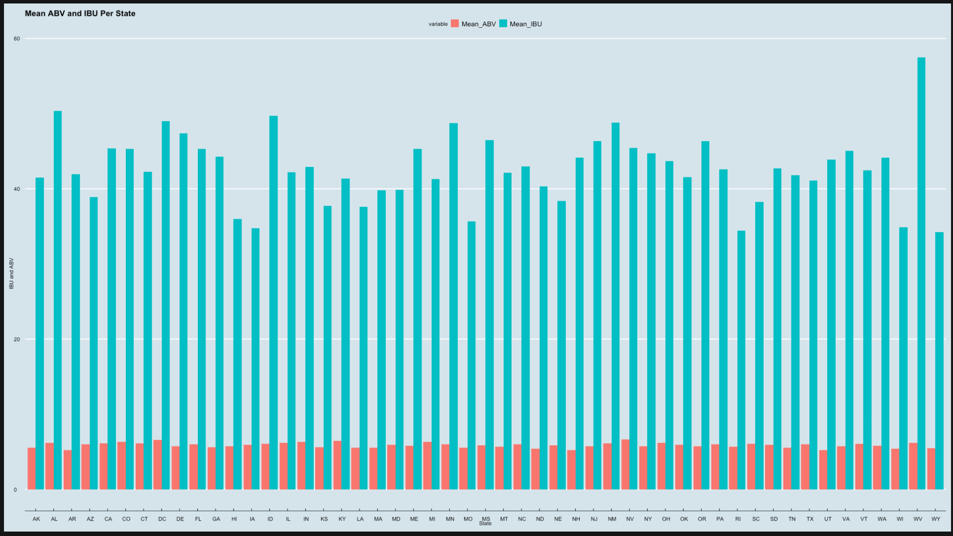

Slide 5

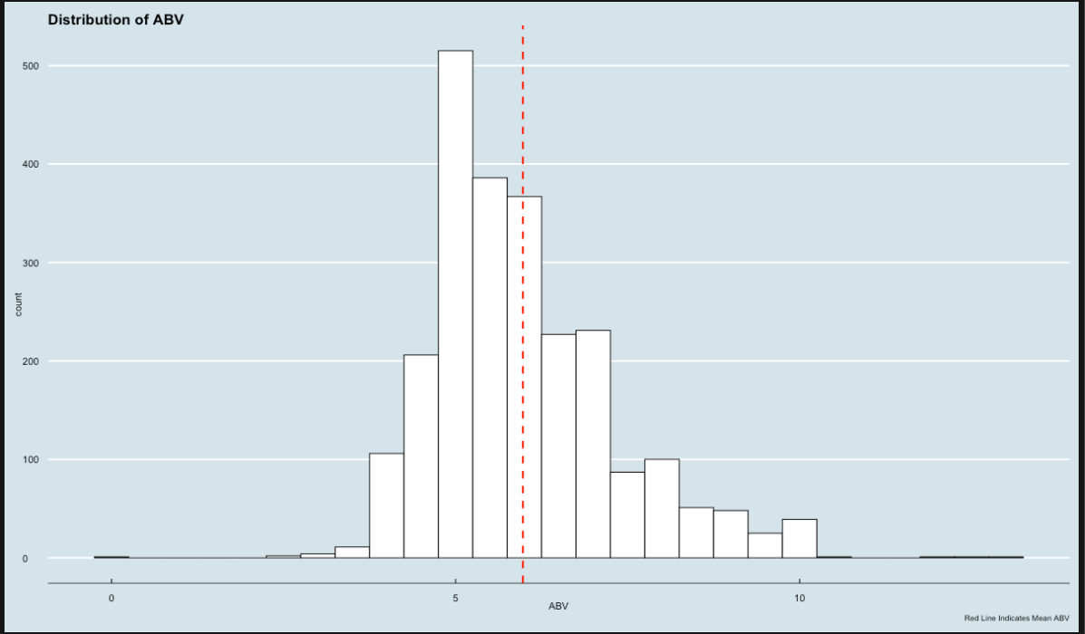
ALCOHOL BY VOLUME
LONG TAIL INDICATES SOME RIGHT SKEWNESS
VAST MAJORITY BETWEEN 5.00 AND 6.70

Slide 6
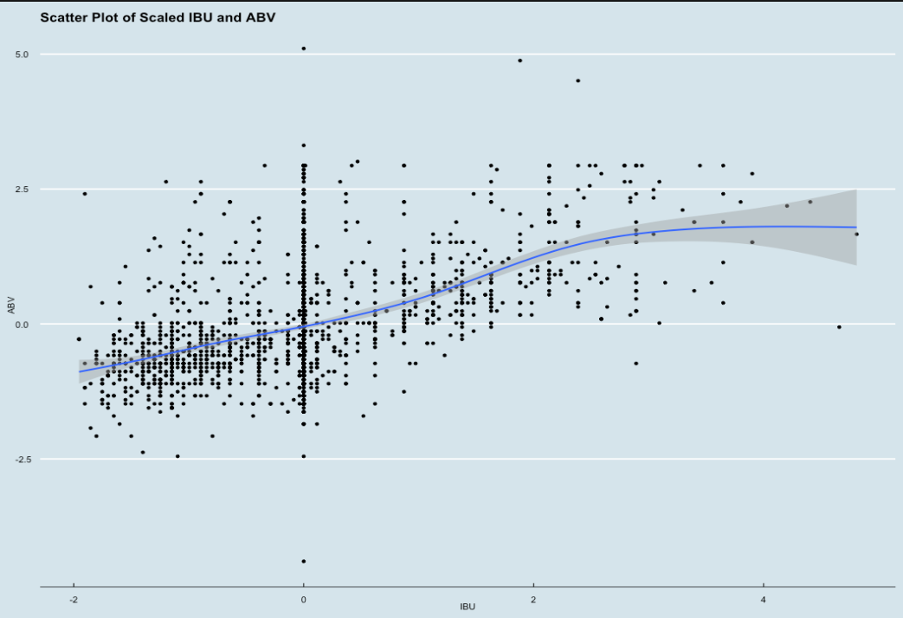
WHY ARE WE HERE?
IS THERE A RELATIONSHIP BETWEEN THE BITTERNESS OF THE BEER AND ITS ALCOHOLIC CONTENT?
COULD THIS BE USED TOWARDS A COMPETITIVE ADVANTAGE?

Slide 7
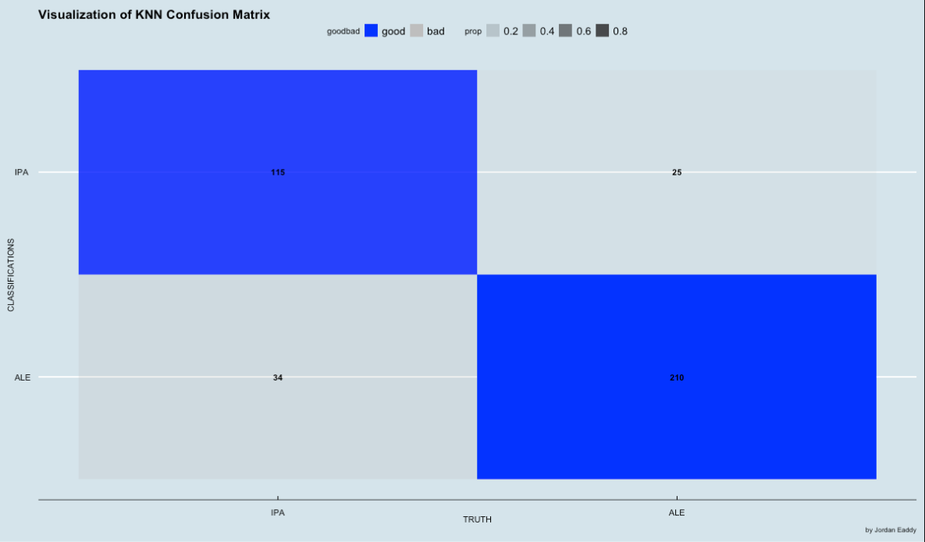
All models are wrong, but some are useful -George e. p. box

Slide 8
Target markets
I’ve identified 12 states that have below average alcohol content, international bitterness and ounces
ALASKA (20)
ARKANSAS (2)
ARIZONA (26)
GEORGIA( 12)
LOUISIANA (12)
MASSACHUSETTS (44)
NORTH DAKOTA (3)
NEBRASKA (17)
RHODE ISLAND (14)
SOUTH DAKOTA( 5)
UTAH (16)
WYOMING (12)
DENOTED IN PARENTHESES IS HOW MANY CITIES WITH BREWERIES THAT MATCHED THE CRITERIA

Slide 9
Thank you for your time
Questions?
Presented By: Jordan Eaddy

Slide 10
Link to GITHUB: https://github.com/JordanEaddy/Case-Study-01-Fall-2021.git
Link to YouTube: https://youtu.be/DmjlSMNduQ8

